Slide 1
Getting Started with
HTML & CSS

Slide 2
HTML
Stands for HyperText Markup Language
Defines the structure and content of a document on the Web
Derived from the conventions of print document layout

Slide 3
What makes good markup?
Readable
Indexable
Accessible

Slide 4
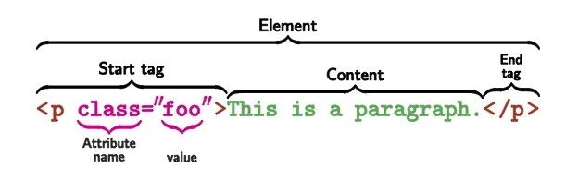
Normal HTML Elements consist of:
A start tag
Name of element surrounded by angle brackets
Attributes
Content
Can include text and/or more nested HTML elements
An end tag
Name of element surrounded by angle brackets, but with a slash after the first bracket
https://en.wikipedia.org/wiki/HTML_element#Elements_vs._tags

Slide 5
Exceptions
Raw text elements
Can not include nested elements
<title>
Void elements
Consist of a single tag with a trailing space and a slash before the closing bracket
May also be called “single”, “empty”, or “standalone” elements
<img />, <br />
Comments
Opened and closed with <!-- and -->
Anything inside the comment will still appear in the source, but will not be rendered in the window

Slide 6
Some very common elements
Paragraphs
<p></p> - probably most basic HTML element there is
Anchors
<a></a> - a clickable hyperlink to a location
Can be a spot in the same page or can be a different page
Not to be confused with the <link /> tag
Headings
Six levels: <h1> through <h6>
<h1> should be the headline or title of the page, and ought to be used just once
<h2> - <h6> can be repeated
Divs
<div> - literally a blank empty box
No special rules or behavior defined by browser

Slide 7
Some very common nested elements
Lists (parent elements)
Ordered lists <ol></ol>
Unordered lists <ul></ul>
Description lists <dl></dl>
List items (child elements)
Ordered and unordered lists both use <li>
Description lists use two child elements:
Description title <dt>
Description detail <dd>

Slide 8
Let’s look at some example HTML
http://localhost:8000

Slide 9
Things to notice
<!DOCTYPE HTML> declaration
Tells the browser what kind of document this is.
Must be at the top of every HTML document.
Indentation of code
Tabs indicate parent-child relationships of elements
<head>
Contains meta content, page title, and stylesheet link
Nothing here shows up in the browser window

Slide 10
Things to notice
<body>
Divided into descriptive blocks: the name of the element tells us what the content inside is
<header> and <footer>
<section>, <article>, and <aside>
<nav>
Special characters are properly encoded
https://www.starr.net/is/type/htmlcodes.html

Slide 11
Applying some simple styles with CSS
CSS stands for Cascading StyleSheets
Style rules can fall or “cascade” from one stylesheet to another
This lets you include multiple stylesheets in a document
Can be in a standalone .css file or in a <style> tag
...but should usually be in a standalone .css file
Should be defined in the <head> of the HTML document

Slide 12
Including a CSS Reset
What’s a CSS Reset?
Different browsers have slightly different default styles
A CSS Reset will correct these inconsistencies
It should be included before any of your own stylesheets
Which one should I use?
https://github.com/necolas/normalize.css appears to be pulling ahead as a popular one, and it’s actively being maintained on GitHub

Slide 13
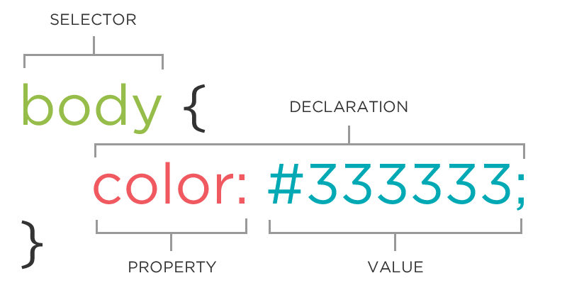
So how do CSS rules work?
Selector: which element(s) do we want to style?
Property: what do we want to change about this element’s appearance?
Value: what do we want this element’s appearance to be?

Slide 14
The Most Common CSS Selectors
element: selects elements by their HTML name
Good for very broad, general rules
Not good for any specific rules
class: selects elements by their “class” property
The most common way to apply styles to elements
Classes can be reused and applied to multiple elements
Elements can have many classes
Classes can be dynamically added and removed via JavaScript to change styles on the fly (more about this later when we start learning JavaScript)
id: selects elements by their “id” property
IDs are unique identifiers that can only be used once per page
No two elements on the page can have the same ID
Generally more useful in JavaScript than in CSS

Slide 15
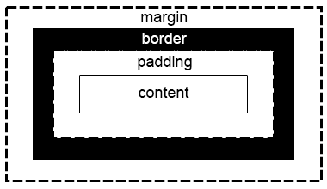
What kinds of things can we do with CSS?
Color rules: text color, background color, etc.
Typography rules: font family, font size, text alignment, etc.
Size rules: fixed sizes (in px or pt) or relative sizes (percentages or em)
Positioning (we’ll come back to this another day)
Margin, border, and padding: the box model

Slide 16
Let’s see some CSS styling in action.
We’ll add some colors from this palette I’ve generated: https://coolors.co/efd19d-8f925d-59b0c4-936e20-b3a13f
We’ll pick some fonts from here: https://www.cssfontstack.com/

Slide 17
What should I have on my portfolio site?
A home page with a brief introduction to you and your work
An about page with a slightly more in-depth bio
A “work” page with examples of your past projects
If you have a lot of work in a number of different fields, each should get its own page- eg, if you have portfolios of both painting and photography, those would be on their own pages
A contact page for getting in touch with you
These rules are not hard and fast. Be creative in how you present yourself and let your character come through.

Slide 18
Handy sources
https://eastmanreference.com/complete-list-of-html-tags
https://css-tricks.com/what-beautiful-html-code-looks-like/
https://webaim.org/
https://css-tricks.com/reboot-resets-reasoning/
https://coolors.co
https://www.cssfontstack.com/
https://www.starr.net/is/type/htmlcodes.html
https://www.lifewire.com/why-use-semantic-html-3468271

Slide 19
For next week
Have a plan for your website started.
Define what the pages of your site will be and what will be on them
Start a GitHub project for your site:
How to: https://pages.github.com/
Add me as a collaborator

